Slide 1
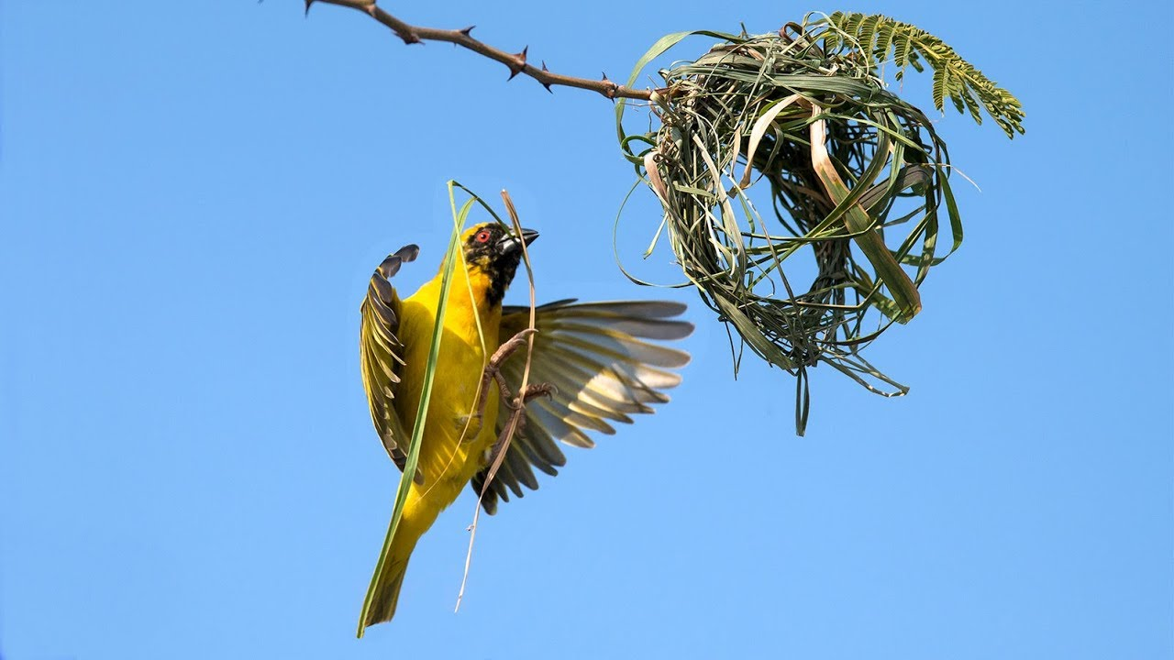
Hard at work
Weaver bird building a nest

Slide 2
Prepared by: Anna Coote & Heather Grain
The coding process
ICD-10-AM 11th edition

Slide 3
Authors
Anna Coote ADip MRA, Dip Tert ED, BA, MHP
Health Information Manger and Clinical Coding Educator
MPH University of NSW
Diploma of Tertiary Education, University of New England
Associate Diploma of Medical Record Administration, College of health Services
Bachelor or Arts, Macquarie University
Heather Grain ADip HIM, Dip TDD, GDip IS, MHI, FAIDH, FMU, FIAHSI
Director of Course Development eHealth Education
Designer and Project Manager eHRol - the Clinical Coder Training Tool
Convener ISO TC215 Health Informatics WG3 Semantic Content
Past Chair HL7 Terminology Authority and Co-Chair Vocabulary
Past Expert SNOMED International Education and representative to Quality and Implementation committees.

Slide 4
Steps in the coding process
1. Identify in the current episode of admitted care, the clinical concept requiring classification
2. Locate the lead term in the appropriate section of the ICD-10-AM Alphabetic Index.
3. Refer to the ICD-10-AM Tabular List to verify the suitability of the code selected
4. Refer to the Australian Coding Standards
5. Refer to national Coding Rules, as appropriate
6. Assign the code.
Notes:
Abstract, verify
Remember signs and symptoms
2. Definition of Lead Term.
Instructional notes in the index eg. reduction dislocation with fracture
Meaning of round brackets / modifiers
See and SEE also instructions
3. Inclusions, exclusions, code also, use additional code.

Slide 5
Lead Term
The Lead Term is the name of the condition or the procedure to be coded.
The Lead Term is the word used to search in the Disease and ACHI index
The index is organised in the form of Lead Term, in alphabetical order
The modifiers under the lead term refer to
the type of condition (eg acute)
The site
Notes:
the lead term is not a body part, and not an adjective (eg. chronic, acute, Etc.)

Slide 6
Coding Conventions
Parentheses ( )
Essential modifiers
Square brackets [ ]
Colon :
Braces{ ]
Text boxes
Code also
Code also when performed
See
See also
Notes:
Reference: Interventions Index, Conventions and general arrangement of the ICD-10-AM Alphabetic index.

Slide 7
Parentheses
Modifiers in parentheses MAY or MAY NOT be present

Slide 8
Parentheses example
K35.2 Acute appendicitis with generalised peritonitis
Appendicitis (acute) with generalised (diffuse) peritonitis (following rupture or perforation)
This code can be assigned for:
Appendicitis with generalized peritonitis
Acute appendicitis with generalized peritonitis
Appendicitis with diffuse generalized peritonitis
Acute appendicitis with diffuse generalized peritonitis
Appendicitis with generalized peritonitis following rupture or perforation
Acute appendicitis with generalized peritonitis following rupture or perforation
Appendicitis with diffuse generalized peritonitis following rupture or perforation
Acute appendicitis with diffuse generalized peritonitis following rupture or perforation
Notes:
The terms in parentheses MAY or MAY NOT be present in the clinical statement – but can still be assigned this code.

Slide 9
Colon
If a word in the Tabular List is followed by a colon, then one of the words after the colon must be present to make the word a valid word for the code
K36 Other appendicitis
Appendicitis:
• chronic
• recurrent
Notes:
Can I assign K36 for “appendicitis”? NO
Can I assign K36 for “chronic appendicitis”? YES
Can I assign K36 for “recurrent appendicitis”? YES

Slide 10
Braces
A brace indicates that neither the words that precede it nor the words after it are complete terms.
O71.6 | Obstetric damage to pelvic joints and ligaments
 | Avulsion of inner symphyseal cartilage Damage to coccyx Traumatic separation of symphysis (pubis) | obstetric

Slide 11
Square Brackets
Square brackets are used to enclose
synonyms,
alternative words,
explanatory phrases or valid characters.
A30 Leprosy [Hansen's disease]
M19.0 Primary arthrosis of other joints
[1–4, 7–9]

Slide 12
SEE and SEE ALSO
See - This is an instruction, you must go to the area that you are asked to SEE
See also - This is a suggestion, it indicates that the area proposed by “see also” may be helpful in finding the correct code.
Code also, and Code also when performed are instructions, which indicate additional codes which must be coded in specific situations.
Notes:
Code also – D70
Code also when performed: 37224-03
See – Abduction contracture in Disease Index
See also – Paralysis, - nerve. Will enable us to find cranial nerve paralysis

Slide 13
Inclusion notes
J44 can be used for:
Includes: chronic:
• bronchitis:
• asthmatic (obstructive)
• emphysematous
• with:
• airways obstruction
• emphysema
• obstructive:
• asthma
• bronchitis
• tracheobronchitis
Notes:
Inclusion Terms tell you what you can use this code for
DO NOT ignore a code from the Index because it is not listed as an inclusion for a code.
Inclusion terms are not exhaustive - the index includes many more terms than the Tabular List
Inclusion terms are listed as a guide to the content of the code

Slide 14
Exclusion notes
A guide. If the application of an exclusion note results a code for one of the clinical concepts not being assigned, then all concepts should be assigned.
An instruction to ensure correct code selection
FOLLOW THE INDEX
IF two conditions are documented
AND neither is listed as a modifier for the other in the index
THEN assign both codes
Notes:
1. guide: OP and Vit D deficiency
2 Instruction: K561 Intussusception excludes intussusception of appendix.

Slide 15
Text boxes
Codes in black reverse text boxes (white print on a black background) are not complete codes
Other arthrosis
Codes in grey reverse text boxes (white print on a grey background) are not complete codeS
M19.0 Primary arthrosis of other joints
Codes in a box outline (black print on a white background, like this box) ARE complete codes
M19.01 Primary arthrosis of other joints, shoulder region

Slide 16
Text boxes
Codes in black reverse text boxes (white print on a black background) are not complete codes
Other arthrosis
Codes in grey reverse text boxes (white print on a grey background) are not complete codeS
M19.0 Primary arthrosis of other joints
Codes in a box outline (black print on a white background, like this box) ARE complete codes
M19.01 Primary arthrosis of other joints, shoulder region

Slide 17
Default codes
A default code is the code assigned when none of the descriptors for the diagnostic text are found in the Index.
Notes:
Use the default code when the descriptors in the diagnostic text are not found as modifiers in the index (either the Disease or ACHI index)
eg. acute pneumonia

Slide 18
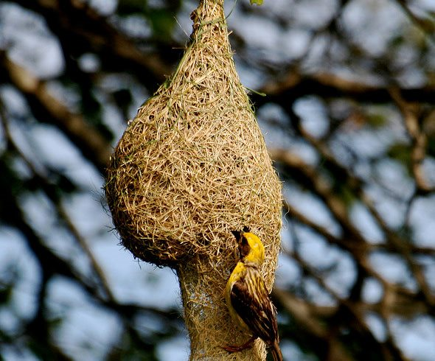
The end of the process
Weaver bird nest

Slide 19
Prepared by: Anna Coote & Heather Grain
The coding process
ICD-10-AM 11th edition

Slide 20

What do coders do?
Notes:
Hairy nosed wombat

Slide 21
Identify statement to be coded
Procedure: Transurethral resection of prostate
Operation description: Indication 42cc prostate on U/S.
Spinal anaesthesia. Lithotomy. Prep. Draps.
22Ch sheath, 30/70 degree cystoscopes.
Cystourethroscopy - Tight urethral meatus. Anterior urethra ok. Prostatic fossa - moderately occlusive lateral lobes. Bladder - UOs identified. No other lesions.
Transurethral resection of prostate - Bladder neck incised peripherally to achieve open outflow channel as viewed endoscopically. SPC.

Slide 22
Identify statement to be coded
Transurethral resection of prostate
Operation description:
Indication 42cc prostate on U/S.
Spinal anaesthesia. Lithotomy. Prep. Draps.
22Ch sheath, 30/70 degree cystoscopes.
Cystourethroscopy - Tight urethral meatus. Anterior urethra ok. Prostatic fossa - moderately occlusive lateral lobes. Bladder - UOs identified. No other lesions.
Transurethral resection of prostate - Bladder neck incised peripherally to achieve open outflow channel as viewed endoscopically. SPC.
Notes:
I have highlighted in red the terms that the CC will note.

Slide 23
Locate the Lead Term
^{Turbinectomy 41689-02 [376]}
⁻ ^{by}
⁻ ^{- cauterisation 41674-00 [374]}
^{- - bilateral 41689-01 [376]}
- total (unilateral) 41689-02 [376]
^{- bilateral 41689-03 [376]}
TURP (transurethral resection of prostate) (with cystoscopy) (see also Prostatectomy) 37203-00 [1165]
Tylectomy (breast) 31500-00 [1744]
- following previous open biopsy or excision 31515-00 [1744]
Notes:
This is an extract from the eBooks in the T section of the alphabetic index.

Slide 24
Read and be guided by any note that appears under the lead term
Includes cystoscopy, suprapubic stab cystostomy, urethroscopy
Excludes: TULIP
Read any terms enclosed in parentheses after the lead term – “ ( “
TURP (transurethral resection of prostate) (with cystoscopy) (see also Prostatectomy) 37203-00 [1165]
Notes:
READ… there are two notes: and Exclusion note and an inclusion note
Parentheses – there are three, including a “see also” note.
At this stage the CC should go to the Lead Term “prostatectomy” as directed by the “see also” note to determine whether there is a more specific entry under that Lead Term.

Slide 25
2. Go to the Tabular List
1165 Transurethral prostatectomy
Includes: cystoscopy, suprapubic stab cystotomy, urethroscopy
Excludes: transurethral ultrasound guided laser induced prostatectomy
37203-00 Transurethral resection of prostate [TURP]
∇ ¹⁴²⁰
Transurethral endoscopic prostatectomy
^{Includes: that by:} ^{cold punch, diathermy}
Notes:
This slide is a copy of the entry for TURP in the Tabular List.
Note the Australian Coding standard – before proceeding we should check what this standard says

Slide 26
ACS 1420
1420 Bladder Neck Incision for Benign Prostatic Hypertrophy
Assign N40 Hperplasia of prostate as the principal diagnosis. Any documented bladder neck obstruction should be coded as an additional diagnosis (N32.0 Bladder neck obstruction). Bladder neck obstruction can be assumed to be due to prostatic hypertrophy unless another condition is stated as the cause.
If a TURP and bladder neck incision are performed, sequence the TURP (37203-00 [1165] Transurethral resection of prostate [TURP]) as the first procedure code and bladder neck incision (36854-00 [1095] Endoscopic incision of bladder neck) as an additional procedure.
Extracted from NCCH eBook, July 2010, Genitourinary System.
Notes:
Our procedure includes a bladder neck incision, and we are instructed to code this as an additional procedure. There is no documentation of bladder neck obstruction – but the CC will be very frustrated with this documentation – was the bladder neck obstructed, why didn’t the surgeon say so – so that I can code it. CODERS MAY NOT ASSUME

Slide 27
Inclusions &/or Exclusions
Includes : cystoscopy, SPC and urethroscopy
Excludes: TULIP
Notes:
So after that small diversion, back to our coding exercise…
We note that the patient had a cystoscopy and an SPC, but these are both included in the code for TURP, so they are not coded.
HG Comments – say in full – some in the group may not know the terms.

Slide 28
Assign the Code
37203-00 [1165] TURP
Notes:
Note the block no. [1165]
Note that a sensible computer system does not require the entry of the “-”
HG Comment: this is more than the code – explain the code, the block (applicable to procedures) and the description of the code.

