Slide 1
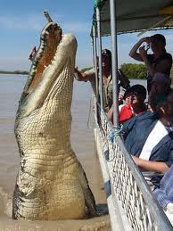
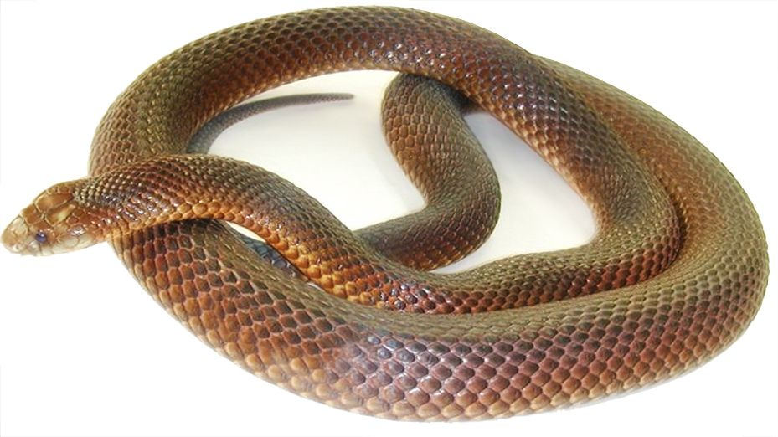
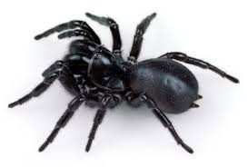
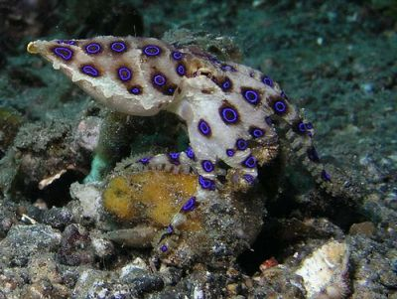
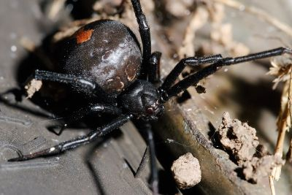
Danger!
© 2014
Notes:
I also forgot to tell you that we have some of the top 10 deadliest creatures in Australia.
Brown snake, funnel web spider, crocodile, blue ringed octopus, red back spider.

Slide 2
Prepared by: Anna Coote & Heather Grain
Poisoning
ICD-10-AM 11th edition

Slide 3
Authors
Anna Coote ADip MRA, Dip Tert ED, BA, MHP
Health Information Manger and Clinical Coding Educator
MPH University of NSW
Diploma of Tertiary Education, University of New England
Associate Diploma of Medical Record Administration, College of health Services
Bachelor or Arts, Macquarie University
Heather Grain ADip HIM, Dip TDD, GDip IS, MHI, FAIDH, FMU, FIAHSI
Director of Course Development eHealth Education
Designer and Project Manager eHRol - the Clinical Coder Training Tool
Convener ISO TC215 Health Informatics WG3 Semantic Content
Past Chair HL7 Terminology Authority and Co-Chair Vocabulary
Past Expert SNOMED International Education and representative to Quality and Implementation committees.

Slide 4
Injury and external cause - explanation
WHAT happened to the body
HOW did it happen
WHERE did it happen
ACTIVITY when it happened

Slide 5
Injuries & poisoning and external causes - sequencing
Code first the injury or poisoning
THEN code the external cause
THEN code the place of occurrence
THEN code the activity where applicable.
Notes:
A quick revision before we look at poisoning
Activity is not applicable for adverse effect in therapeutic use, legal interventions and war, allergy, complications of medical and surgical care and sequelae.

Slide 6
Australian Coding Standards for Poisoning
ACS 1901 Poisoning
ACS 19012 Adverse effects
ACS 1903 Two or more drugs taken in combination
Notes:
There are 3 ACS for poisoning

Slide 7
Coding Poisoning
Poisoning requires:
A code for the drug causing the poisoning
A code for the external cause
Accidental*
Suicide, self harm*
Undetermined intent*
Adverse effect
Place of occurrence
*Activity codes
Notes:
Activity code is not required for Adverse effect in therapeutic use
Where do we find these codes?

Slide 8
Table of drugs and chemicals
Adverse Poisoning effect in
Chapter 19 Accidental Intentional Undetermined therapeutic
^{Self-harm intent use}
Abacavir T37.5 X44 X64 Y14 Y41.5
Abciximab T45.5 X44 X64 Y14 Y44.4
Assign first a chapter 19 code, followed by ONE code from the external cause options
Notes:
The codes for poisoning are found in the Table of Drugs and Chemicals, - the 3rd part of the Diseases Index.
It is important to understand the meaning of the external cause headings.

Slide 9
External cause - accidental
^{accidental overdose of drug}
wrong drug given or taken in error
^{drug taken inadvertently}
accidents in the use of drugs, medicaments and biological substances in medical and surgical procedures
Notes:
took the drug more than once (elderly), thinking it was something else, child taking mothers meds., nurse error – given twice. Stated taken to “sleep” and no suicide intent.

Slide 10
External cause – intentional self harm/suicide
purposely self-inflicted poisoning or injury
^{suicide (attempted).}
Note : Activity code is U73.8 Other specified activity
Notes:
Intending to suicide or self harm – cutting, suicide
Index entry: Activity, - suicide

Slide 11
External cause – undetermined intent
self inflicted injury without stated or implied intent to self harm.
the intent is unspecified or cannot be determined
Notes:
No documentation of intent. Took the drug at a party Stated taken to “sleep” and no suicide intent. The HOW is not known.

Slide 12
Coding poisoning – accidental, self harm, undetermined intent
Assign a code from chapter 19
Assign the code for the manifestation of the poisoning if documented
Assign the code for the external cause for the poisoning
Assign the code for the place of occurrence
Assign the code for the activity
Notes:
Coma due to heroin overdose – code T40.1 heroin and then R40.2 for coma.

Slide 13
Coding adverse effect in therapeutic use
Assign a code for the poisoning
Either
a) A code from chapter 19
OR
b) A code for the manifestation and NOT a code from chapter 19
2. Assign the code for the manifestation of the poisoning if documented
3. Assign the code for the external cause for the poisoning
4. Assign the code for the place of occurrence
5. No activity code is assigned for adverse effect.
Notes:
The rule for coding adverse effect differs to the other external causes

Slide 14
Poisoning by combinations of drugs
Medication combined with alcohol - code all drugs including alcohol
Prescribed + non-prescribed drug – code both drugs
Combination of two or more prescribed drugs – code both drugs
A combination drug (panadeine) – code all components of the drug.
A combination drug with a component specified as causing the adverse effect – code the specific component only.
Notes:
Panadeine is two drugs: paracetamol and codeine. Code both.

Slide 15
Allergy
No external cause is required
The external cause information is embedded in the diagnosis code
L23.0 Allergic contact dermatitis due to metals
Notes:
Use the Lead Term Allergy and follow the modifiers and see/see also notes.

Slide 16
Use of psychoactive substances (F10 – F19)
Alcohol
Opioids
Cannabinoids
Sedatives/hypnotics (benzodiazepine)
Cocaine
Stimulants (caffeine)
Hallucinogens
Tobacco
Volatile solvents
Multiple and other
Notes:
Coders can confuse poisoning with use of psychoactive substances, for eg intoxication/dependence on alcohol VS alcohol poisoning.

Slide 17
Coding behavioural disorders due to psychoactive substances
Acute intoxication
Harmful use
Dependence
Withdrawal
Withdrawal with delirium
Psychotic disorder
Amnestic syndrome
Residual & late-onset psychotic disorder
Other
Unspecified
Notes:
These are the 4th digit codes for the condition due to the psychoactive substance.

Slide 18
Poisoning Vs Drug use
Alcohol poisoning Vs alcohol intoxication
Coma due to heroin Vs heroin use or dependence
Cannabinoid hyperemesis Vs use of cannabis
Notes:
The first term is a poisoning, the second is coded from the range F10 – F19
Coders need to differentiate between poisoning, and disorders due to psychoactive substances, with the help of clinical documentation.

Slide 19

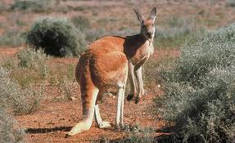
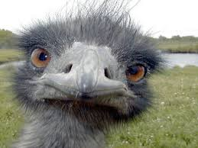
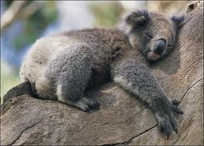
AUSTRALIA
© 2014
Notes:
I forgot to say that there are some really great things about Australia. And we’re the only country that eats the animals on our coat of arms.
Big red, ringtail possum, emu, koala, platypus.

Slide 20
Prepared by: Anna Coote & Heather Grain
Poisoning
ICD-10-AM 11th edition

