Slide 1

Complications

Slide 2
Prepared by: Anna Coote & Heather Grain
Coding pregnancy, childbirth and the puerperium
Conditions & injuries in pregnancy

Slide 3
Authors
Anna Coote ADip MRA, Dip Tert ED, BA, MHP
Health Information Manger and Clinical Coding Educator
MPH University of NSW
Diploma of Tertiary Education, University of New England
Associate Diploma of Medical Record Administration, College of health Services
Bachelor or Arts, Macquarie University
Heather Grain ADip HIM, Dip TDD, GDip IS, MHI, FAIDH, FMU, FIAHSI
Director of Course Development eHealth Education
Designer and Project Manager eHRol - the Clinical Coder Training Tool
Convener ISO TC215 Health Informatics WG3 Semantic Content
Past Chair HL7 Terminology Authority and Co-Chair Vocabulary
Past Expert SNOMED International Education and representative to Quality and Implementation committees.

Slide 4
Obstetric complications
See ∇ACS 1521 conditions complicating pregnancy
Non-obstetric complications complicating pregnancy
Non-obstetric complications NOT complicating pregnancy
Non-obstetric injuries/poisoning in Pregnancy
Notes:
The detail in this standard has been significantly expanded.

Slide 5
For conditions complicating pregnancy - use lead term
Pregnancy
- complicated by
- - the condition
If the condition is not listed using this pathway, then you should Lead Term,
Pregnancy
- complicated by
- - conditions in
^{- - - A00–A07 O98.8}
^{- - - F00–F52 O99.3}
^{- - - F54–F99 O99.3}
^{- - - G00–G99 NEC O99.3}
^{- - - H00–H95 O99.8}
^{- - I00–I09 O99.4}
- - - I10–I15, pre-existing O10
^{- - - I20–I99 O99.4}

Slide 6
Non-obstetric complications complicating pregnancy
IF Pregnant
AND admitted for a non-obstetric complication
AND care is provided for the pregnancy
AND the condition is in the Index Pathway
Pregnancy
- complicated by
- - Etc.
THEN assign the chapter 15 code
THEN assign the condition from the other Chapters
Notes:
Care = Patient is admitted to an obstetric unit
Patient is supervised/evaluated by an obstetrician, midwife and/or neonatologist
Fetal evaluation and/or monitoring is performed
Patient is transferred to another facility for obstetric and/or neonatal care
CLASSIFICATION Assign a code from Chapter 15 Pregnancy, childbirth and the puerperium for a non-obstetric condition complicating pregnancy as per the Alphabetic Index (eg Pregnancy/complicated by or condition/in pregnancy or condition/in pregnancy, childbirth or puerperium). Assign as an additional diagnosis a code from another chapter to add specificity to the Chapter 15 code

Slide 7
Example: non-obstetric conditions complicating pregnancy
Use the Lead Term:
Pregnancy
- Complicated by
- carpal tunnel syndrome O99.3
And then also assign the code for carpal tunnel syndrome G56.0
^{EXAMPLE 1:}
A pregnant patient was admitted with carpal tunnel syndrome for decompression of the median nerve. After the procedure, the patient was transferred to the obstetric unit, and reviewed by the midwife.
O99.3 Mental disorders and diseases of the nervous system in pregnancy, childbirth and the puerperum
^{G56.0 Carpal tunnel syndrome}
Notes:
CTS is in the Index pathway “pregnancy complicated by…” Code both the obstetrics and the other chapter code

Slide 8
Non-obstetric complications complicating pregnancy
IF Pregnant
AND admitted for a non-obstetric complication
AND care is provided for the pregnancy
AND the condition is NOT in the Index Pathway Pregnancy - complicated by, --
THEN assign the chapter 15 code
THEN assign the condition from the other Chapters
Notes:
See next slide for example

Slide 9
Pregnancy complicated by – condition not in index pathway
Pregnancy
- Complicated by
- - conditions in
- - - E50-E89 O99.2
Text | Codes
Pregnancy complicated by dehydration | O99.2 Endocrine, …disease in pregnancy….
Dehydration | E86 Volume depletion
Notes:
Pregnancy complicated by dehydration is not in the index pathway – assign the obstetrics code and the other chapter code. This rule applies to whether in the pathway or not.

Slide 10
Non-obstetric complications NOT complicating pregnancy
^{CLASSIFICATION}
Assign codes as per the criteria in:
ACS 0001 Principal diagnosis and ACS 0002 Additional diagnoses
Assign: Z33 Pregnant state, incidental as an additional diagnosis
Note: Z33 should never be assigned when a code from Chapter 15 Pregnancy, childbirth and the puerperium is assigned in the same episode of care.

Slide 11
Non-obstetric complications NOT complicating pregnancy
IF Pregnant
AND admitted for a non-obstetric complication
THEN code the non-obstetric complication
THEN assign Z33

Slide 12
Pregnancy complicated by – condition not in index pathway
Admitted for dehydration – went for a long walk in hot weather and forgot to take water. Patient is also pregnant. IV fluids and then discharged.
Dehydration Also pregnant | E86 dehydration Z33 Pregnant state, incidental
Notes:
Pregnancy complicated by dehydration is not in the index pathway – assign the obstetrics code and the other chapter code. This rule applies to whether in the pathway or not.

Slide 13
Non-obstetric injuries/poisoning in pregnancy
IF Pregnant
AND injured
THEN code the injury and external cause codes
THEN assign Z34.- Supervision of normal pregnancy
IF Pregnant
AND injured
AND an obstetric condition also meet ACS 0002 for the admission
THEN code the injury and external cause codes
THEN assign the code for the obstetric condition

Slide 14
Coding puerperal/postpartum non-obstetric injuries
Assign the following codes:
A Chapter 15 code. Use the Lead Term
Puerperal, Puerperium
A second code to specify the condition where there is a Code also instruction
Notes:
Injuries – see example 13
For eg. code also the infection
“Non-obstetric injuries/poisoning (conditions classified to Chapter 19 Injury, poisoning and certain other consequences of external causes) are never assigned a puerperal/postpartum code”

Slide 15
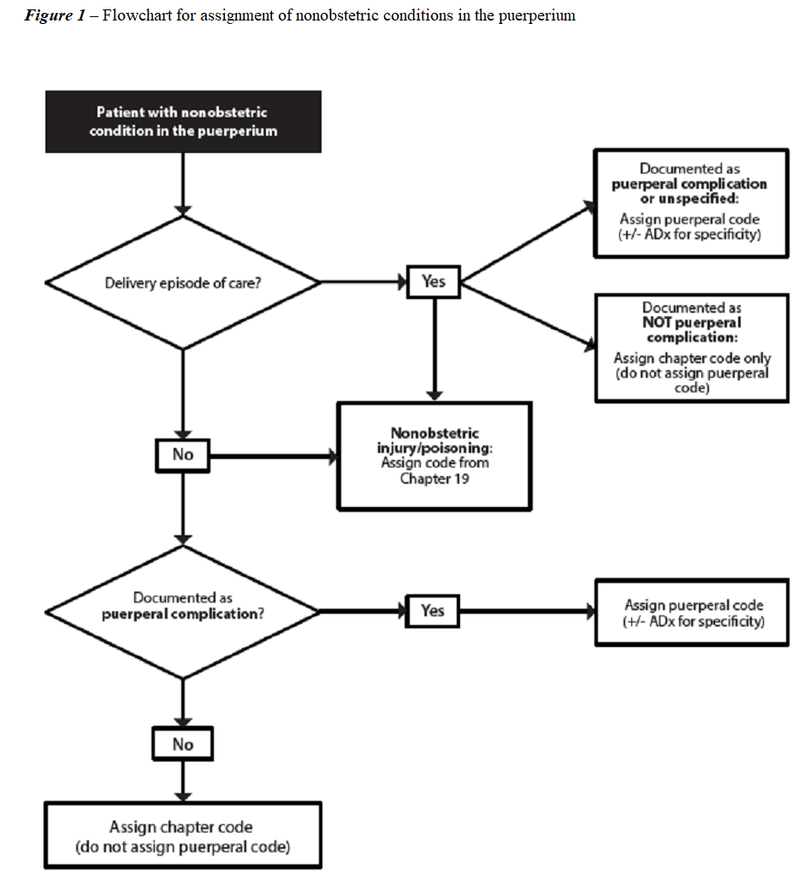
Flowchart from ACS 1548
Copied from ACS 1548 in ICD-10-AM 10th Edition, Australian Coding Standards

Slide 16
1552 PREMATURE RUPTURE OF MEMBRANES, LABOUR DELAYED BY THERAPY
IF Premature rupture of membranes
AND a tocolytic agent has been administered
AND onset of labour within 24 hours
THEN assign O42.2
IF Premature rupture of membranes
AND a tocolytic agent has been administered
AND onset of labour greater than 24 hours of PROM
THEN O42.1-
Notes:
O42.1- Excludes: with labour delayed by therapy (O42.2)

Slide 17
1548 Puerperal/postpartum condition or complication
IF a delivery episode
AND a puerperal condition or complication
THEN assign a puerperal/postpartum code
THEN assign a code from another chapter for specificity
IF a NON delivery episode
THEN assign a puerperal/postpartum code
ONLY when documented as puerperal/postpartum
Notes:
Puerperium 42 days or 6 weeks
Non-obstetric injuries/poisoning are never assigned a puerperal/postpartum code
Where documentation indicates that a non-obstetric condition is not puerperal, assign codes as per ACS 0001 and 0002.

Slide 18
Z39.- as Principal Diagnosis
When a patient has delivered (baby and placenta) prior to an episode of care,
^{And}
no post delivery interventions are performed during the episode of care,
^{or}
the mother does not have a puerperal/postpartum condition or complication
When a patient is transferred from another facility following delivery to accompany a sick child, and only receives routine postpartum care at the receiving hospital
When a patient is transferred from another facility for post delivery care, with no condition meeting the definition of principal diagnosis or additional diagnosis,
Notes:
Z390 postpartum are is ONLY assigned for episodes of care AFTER the delivery episode, and within the puerperal period
Most often used for delivery out of hospital (at home, in the ambulance, etc.)

Slide 19
Post caesarean care
Assign Z48.8 Other specified surgical follow-up care as an additional diagnosis when the patient is receiving post-caesarean care

Slide 20
Postpartum care and examination immediately after delivery
IF admitted after delivery
AND no post delivery intervention
AND no puerperal/postpartum condition or complication
THEN code the non-obstetric complication
THEN assign Z39- Postpartum care and examination as the Principal Diagnosis
Notes:
But only within the puerperium 42 days or 6 weeks.
Z39.- is assigned as it is the only available code – no condition, no other reason for admission.

Slide 21
Z39.- as Additional diagnosis
care and examination immediately after delivery
immediately after delivery
When a patient has delivered (baby and placenta) prior to an episode of care and:
post delivery interventions are performed during the admitted episode of care,
^{or}
the mother has a puerperal/postpartum condition or complication
Notes:
Code the condition as the PDx followed by Z39.-
See the examples in ACS 1548
It’s easy to forget to assign this code after the conditions

Slide 22
Postpartum care and examination immediately after delivery
IF admitted after delivery
AND there is a post delivery intervention
OR there is a puerperal/postpartum condition or complication
THEN assign first the condition or complication
THEN assign Z39- Postpartum care and examination as an Additional Diagnosis

Slide 23
Decreased Fetal movements
The lead Term is Decrease(d)
- fetal movements (no underlying cause) NEC O36.8
- - underlying cause identified — see condition
IF decreased fetal movements with an underlying cause
ITHEN code the underlying cause.
IF no underlying cause for decreased fetal movements and NO DELIVERY
THEN code Z36.8 Other antenatal screening.
IF no underlying cause for decreased fetal movements and patient delivers
THEN code O36.8 Maternal care for other specified fetal problems
Notes:
See the instruction – underlying cause – code the condition.

Slide 24

Twins

Slide 25
Prepared by: Anna Coote & Heather Grain
Coding pregnancy, childbirth and the puerperium
Conditions & injuries in pregnancy

