Slide 1
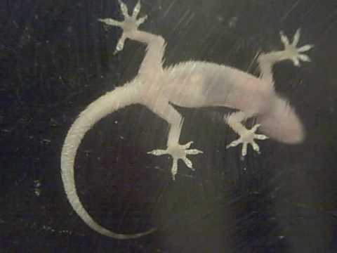
Gecko through glass

Slide 2
Prepared by: Anna Coote & Heather Grain
Minimally invasive procedures
Endoscopy
ICD-10-AM 11th edition

Slide 3
Endoscopy
Gastroscopy
Colonoscopy
Cystoscopy
Arthroscopy
Bronchoscopy
Endoscopic retrograde cholangiopancreatography (ERCP)
Notes:
Note that all of the information in this session applies to all of these types of endoscopy

Slide 4
ACS 0024 Panendoscopy
The term “Panendoscopy” covers endoscopies of the digestive tract
Both lead terms Panendoscopy and Gastroscopy lead to [1005]
Endoscopy including the ileum: Use the lead term Ileoscopy
Notes:
HOWEVER the term panendoscopy can also be used to mean endoscopies of the respiratory tract and the urinary system and therefore nongastrointestinal endoscopies should be coded appropriately, to the furthest site viewed.
WHERE a modifier cannot be found under either gastroscopy or panendoscopy, then check the other lead term. Eg. Via camera capsule can be found via panendoscopy, but not via gastroscopy.
Double balloon gastroscopy is under Panendsocopy

Slide 5
ACS 0051 and ACS 0052 Endoscopy
Applies to:
Same-day patients
Intended same-day patients
Notes:
Intended includes admitted the day before the procedure for support/supervision with the endoscopy preparation or because a day only admission is not possible or practicable for them (eg elderly patients, those who live in a remote location).

Slide 6
Terms relating to ACS 0051 and ACS 0052
An indication is the reason for the admission/procedure.
A Finding is the condition found during the procedure.
A causal link is a statement by the clinician of a relationship between the indication and the finding.
Notes:
Indication may be synonymous with symptoms
A causal link may be documented as “due to” or “indicative of”, or similar terms.

Slide 7
ACS for Endoscopy
∇ACS 0051 Same-day endoscopy – diagnostic.
∇ACS 0052 Same-day endoscopy – surveillance.
∇ACS 0024 Panendoscopy.

Slide 8
Diagnostic endoscopy
The endoscopy is being undertaken to determine a diagnosis for a patient who has symptoms/indications that require investigation to confirm/deny a condition.
The result of a diagnostic endoscopy may be that:
the indication/symptoms are the only conclusion, or
there is an underlying condition (the finding) causing the symptoms.

Slide 9
Coding a diagnostic endoscopy
If a condition (the finding) is found and is stated to be the cause of the reason for the admission (the indication), then the finding and not the reason for the admission is assigned a code. All other findings are also coded (ACS 0002 does not apply).
∇ACS 0002 Additional Diagnoses DOES NOT APPLY to cases meeting the requirements of ∇ACS 0051.

Slide 10
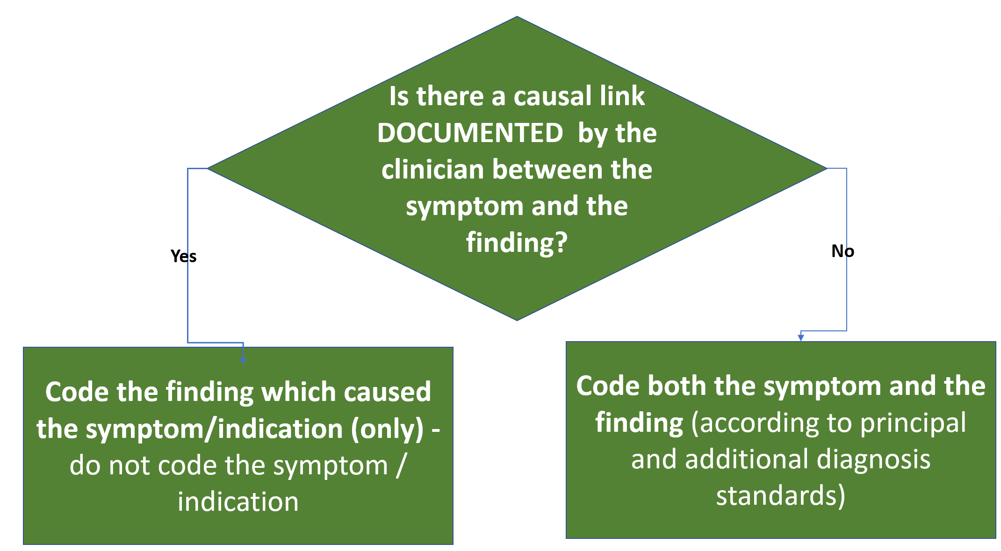
Causal Link
Notes:
Eg. abdo pain and gastritis.

Slide 11
Coding incidental findings for day-stay endoscopy ACS 0051
“assign codes for all other findings as additional diagnoses (note these findings do not need to meet the criteria in ACS 0002 Additional diagnoses).”
Reference ACS 0051, Classification, 1.1, dot point 2
Notes:
Eg. xxx also noted ← code xxx it is an incidental finding.

Slide 12
Screening Surveillance
Examination of people with:
No symptoms, with
A personal history of a condition
A family history of a condition
Risk factors

Slide 13
Screening for chronic conditions
Code the condition for screening for chronic conditions:
Crohn’s disease
Ulcerative colitis
The condition has not been eradicated or cured.

Slide 14
Surveillance for personal history of malignancy
IF personal history of a malignant neoplasm
AND no neoplasm is found
THEN code PDx Z08.x (Lead Term Examination, - follow-up, - - malignant…)
THEN Z85.x .-(Lead Term History (of)(personal), - malignant neoplasm)
IF personal history of a malignant neoplasm
AND the neoplasm is found
THEN code PDx the neoplasm
AND not Z85.x
AND not Z08.-
Notes:
If not malignant, then Examination, - follow up, - - surgery, Z090
History (personal),

Slide 15
Example personal history
Personal history of sigmoidectomy for cancer of the colon. Colonoscopy found no cancer.
Z08.0 Follow-up examination after surgery for malignant neoplasm
Z85.0 Personal history of malignant neoplasm of digestive organs
Notes:
Code first the screening code THEN the history code
If the cancer were found, then code the cancer ONLY
If not malignant, then Examination, - follow up, - - surgery, Z090
History (personal), - colonic polyps/disease – digestive
If no documentation of surgery, then Z099 or Z089

Slide 16
Surveillance for family history
IF family history of a condition
AND no condition is found.
THEN code PDx Z11 or Z12 or Z13 (Lead Term Screening, - neoplasm/disease)
THEN assign a code from Z80.- or Z85.- (Lead Term History, - family)
IF family history of a condition
AND the condition is found.
THEN code PDx the condition
THEN a code from Z80.- or Z85.-(Lead Term History, - family)
AND not Z11/2/3

Slide 17
Example family history
Colonoscopy for family history of colonic polyps
Z13.83 Special screening examination for digestive tract disorder
Z83.7 Family history of diseases of the digestive system
Notes:
Screening, disorder, gastrointestinal
History, family, disease, digestive

Slide 18
Lead terms for surveillance
Lead term for the PDx for admission for a Family History is Screening
Lead term for the PDx for a personal history is Examination

Slide 19


Slide 20
Prepared by: Anna Coote & Heather Grain
Minimally invasive procedures
Endoscopy
ICD-10-AM 11th edition

