Slide 1
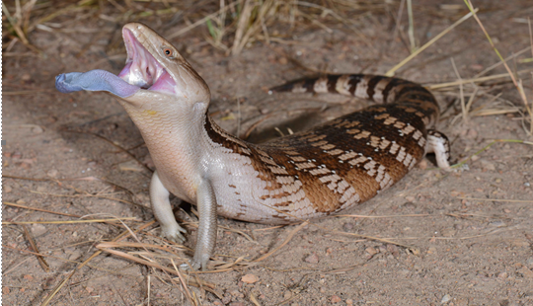
Blue tongue lizard

Slide 2
Prepared by: Anna Coote & Heather Grain
Coding interventions using ACHI
ICD-10-AM 11th edition

Slide 3
Authors
Anna Coote ADip MRA, Dip Tert ED, BA, MHP
Health Information Manger and Clinical Coding Educator
MPH University of NSW
Diploma of Tertiary Education, University of New England
Associate Diploma of Medical Record Administration, College of health Services
Bachelor or Arts, Macquarie University
Heather Grain ADip HIM, Dip TDD, GDip IS, MHI, FAIDH, FMU, FIAHSI
Director of Course Development eHealth Education
Designer and Project Manager eHRol - the Clinical Coder Training Tool
Convener ISO TC215 Health Informatics WG3 Semantic Content
Past Chair HL7 Terminology Authority and Co-Chair Vocabulary
Past Expert SNOMED International Education and representative to Quality and Implementation committees.

Slide 4
Steps in the coding process
1. Identify in the current episode of admitted care, the clinical concept requiring classification
2. Locate the lead term in the appropriate section of the ICD-10-AM Alphabetic Index.
3. Refer to the ICD-10-AM Tabular List to verify the suitability of the code selected
4. Refer to the Australian Coding Standards
5. Refer to national Coding Rules, as appropriate
6. Assign the code.
Reference: ICD-10-AM Diseases Tabular, Introduction, Guidance in the use of ICD-10-AM
Notes:
Abstract, verify
2. Definition of Lead Term.
Instructional notes in the index eg. reduction dislocation with fracture
Meaning of round brackets / modifiers
See and SEE also instructions
3. Inclusions, exclusions, code also, use additional code.

Slide 5
Finding a block [ ]
Go to the Interventions Tabular List
Go to Appendix B
Find your code in the numerical list
Note the block number

Slide 6
ACHI index
Appendicectomy (incidental) (open) 30571-00 [926]
- laparoscopic 30572-00 [926]
Notes:
Appendicectomy use the Lead term and view the options in the index. Cho

Slide 7
Tabular List - appendicectomy

Slide 8
Lead term – tonsillectomy
Tonsillectomy 41789-00 [412]
- with
- - adenoidectomy 41789-01 [412]
- - uvulectomy (partial) (total)
- - - and partial palatectomy 41787-01 [404]
- - uvulopalatopharyngoplasty 41786-01 [405]
- lingual 41804-00 [412]
- tag 41789-00 [412]

Slide 9
Tabular List – tonsillectomy [412]

Slide 10
Prepared by: Anna Coote & Heather Grain
Coding interventions using ACHI
ICD-10-AM 11th edition

