Slide 1

Are you ready to start?
Emu

Slide 2
Prepared by: Anna Coote & Heather Grain
Introduction to Casemix
for Clinical Coders

Slide 3
Authors
Anna Coote ADip MRA, Dip Tert ED, BA, MHP
Health Information Manger and Clinical Coding Educator
MPH University of NSW
Diploma of Tertiary Education, University of New England
Associate Diploma of Medical Record Administration, College of health Services
Bachelor or Arts, Macquarie University
Heather Grain ADip HIM, Dip TDD, GDip IS, MHI, FAIDH, FMU, FIAHSI
Director of Course Development eHealth Education
Designer and Project Manager eHRol - the Clinical Coder Training Tool
Convener ISO TC215 Health Informatics WG3 Semantic Content
Past Chair HL7 Terminology Authority and Co-Chair Vocabulary
Past Expert SNOMED International Education and representative to Quality and Implementation committees.

Slide 4
Objectives
Types of payment for hospital services
Casemix payment
Diagnosis related groups
Implications for clinical coders
Notes:
This will be a very brief introduction to Casemix payment and its implications for clinical coders.
It is not intended to be a comprehensive overview,
Types of payment – what are the options, historical and current, and most efficient

Slide 5
Types of payment for hospital services
Fee-for-service
Discounted fee-for-service
Capitation
Casemix
Notes:
Fee for service – every service is paid for – medications, nursing care, surgery, allied health, food, etc.
Discounted – a fee schedule is set by the authority
Capitation – a fee for the number of people enrolled in the service
Casemix – let’s look at this in detail.

Slide 6
Casemix
A patient classification that provides a clinically meaningful way of relating:
the types of patient treated in a hospital to
the resources used by the hospital
in the treatment of the similar patients
Why – to:
provide a job costing system for healthcare
group patients of similar cost, disorder and treatment
Notes:
This is a useful definition, and the rest of this presentation will explain how this happens.
It’s a patient classification
Types of patient: - not who they are, but their condition and treatment
Eg. all patients having a knee arthroscopy – similar resources regardless of what was done by arthroscopy, or the reason.
Eg. all patients having a lung transplant

Slide 7
What is a Diagnosis Related Group (DRG)
The basis of the casemix system
A DRG is a code that is created by an algorithm, that uses:
Codes for diagnoses and procedures
Patient age
Patient sex
Length of stay
Notes:
There can be other criteria, eg. type of discharge, same day status, mental health status.
The important thing to note is that it’s your codes for Dx and Procedures that are important in this algorithm.
Reason for admission – the PDx – important part of CC’s work
Additional Dxes – important part of CC’s work, especially when not provided by the clinician
Patient age – over a particular age, and under a particular age (don’t ask me I’m a coder not a grouper) the DRG will increase compared to a patient who is not elderly or very young.
AUTOMATIC – DRGs are calculated by a computer system, not by people.

Slide 8
How the algorithm may work
Inguinal or femoral only
N
313
Hernia
Age >9
314
Y
Y
N
OR procedure
315
Com &/or comorbidity
318
Other Dig system OR procedure
3
319
Notes:
Com = complication &/or morbidity

Slide 9
DRG 314
DRG 314 INGUINAL & FEMORAL HERNIA PROCEDURES AGE >9
OPERATING ROOM PROCEDURES
Unilateral inguinal hernia repair | Bilateral direct/indirect inguinal hernia repair
Repair direct inguinal hernia | Bilateral direct inguinal hernia repair - graft
Repair indirect inguinal hernia | Bilateral indirect inguinal hernia repair – graft
Direct inguinal hernia repair – graft | Bilateral direct/indirect inguinal hernia
Indirect inguinal hernia repair – graft | Bilateral inguinal hernia repair – graft
Bilat inguinal hernia repair | Unilateral femoral hernia repair
Bilateral direct inguinal hernia repair | Bilateral femoral hernia repair – graft
Bilateral indirect inguinal hernia repair | Bilateral femoral hernia repair
Notes:
All of the listed procedures are of the same type and are considered to have the same resource use

Slide 10
DRG structure
4 DIGIT NUMERIC STRUCTURE
Eg. A12B
The last digit indicates the level of the DRG
A – the highest weight for a DRG
B – the second highest weight for a DRG
C – the third highest weight for a DRG
D – the fourth highest weight for a DRG
Z – no split (DRGs with a final digit of Z have no other possible last digit)

Slide 11
DRG costweight
DRG COST WEIGHT
average cost of a DRG compared to the AVERAGE COST
It is a representation the of the difference in cost of a DRG to the average cost.
Hence:
Each DRG has a Cost Weight, which can then be translated into a monetary unit (dollars, riyals, etc.).
Notes:
Average cost – = cost of providing inpatient services for all episodes of care in the period / total number of episodes in the period – all episodes all care
i.e. The average cost of an episode of care. This figure is often calculated from actual figures from past years, then rounded up or down to an agreed amount to be applied in a given year e.g. $5,000 average cost in 2014.
Note: costs include all costs, direct and indirect.
Average cost of all DRGs - a process of determining the cost of the diagnoses and procedures for health care facilities, including but not limited to food, linen, maintenance, medical records, surgery, salaries of clinical staff (nurses doctors, PT, etc)

Slide 12
Determining cost weight
Here’s a fictitious example for DRG X12Z:
Average Cost Weight for the year 2014 = $5000.00
DRG: X12Z weight = 0.500
$5,000 X 0.500 = $2.500.00
A case with DRG X12Z is considered to have a service delivery cost of $2500.00
This weight can then be used to pay the hospital for the service

Slide 13
This means that there is only one calculation of the price to be paid for an admission.
All procedures, products, and services are covered within the cost weight for the calculated DRG
NOTE: The average length of stay for a DRG is also calculated.
Notes:
This includes nursing, pharmaceuticals, cleaning, radiology, pathology, etc.
Coders will find that after coding they check the resultant DRG to see if it represents the episode that they have coded.

Slide 14

DRG creep
Process where hospitals manipulate diagnostic information to achieve DRGs with higher weights in order to receive high payment.
Diamond Python
Notes:
Coders must resist pressure (doctors, admin, finance) to “up-code”, eg. add a code that does not meet the ACS.
Clinical Coding audits are essential to ensure that everyone is playing the game fairly.
Diamond python

Slide 15
What are the implicatios of Casemix payment for coders?
We need a set of rules to provide consistency
We have to focus on accuracy
We have to abstract and code all conditions meeting the standards and reject those that do not meet the standards
We have to be aware of mis-use of the system
We have to participate in continuing education
We have to enthusiastically participate in auditing as a tool for improvement
Notes:
Casemix payment results in a less complicated billing system for health care facilities.
Consistency – eg what is the PDx? Reason for admission. Determined by the clinician. Condition requiring most resources.
Accuracy – incorrect codes can result in incorrect billing, incorrect planning, etc.
Abstracting – abstracting and then determining which conditions and procedures meet the standards is at the core of the system
Misuse – we need to understand and be ready to resist
Education – procedures/diagnoses change
Auditing – essential to confirm accuracy, and very useful for coders to learn from mistakes and improve skills.

Slide 16
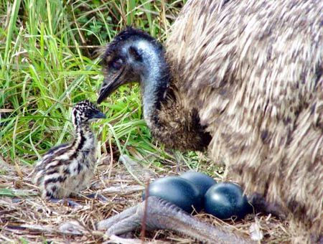
Any questions?
Male emu with eggs and chic
Notes:
THIS HAS BEEN A VERY BRIEF OVERVIEW, THERE’S A LOT MISSING, BUT I THINK IT IS SUFFICIENT TO INTRODUCE YOU TO THE IDEA OF CASEMIX AND DRGs AT THE START OF A WORKSHOP ON IMPLEMENTING CLINICAL CODING AS PART OF A MOVE TO ABF.
See next slides for examples of how DRGs change depending on the conditions coded.

Slide 17
Prepared by: Anna Coote & Heather Grain
Introduction to Casemix
for Clinical Coders

Slide 18
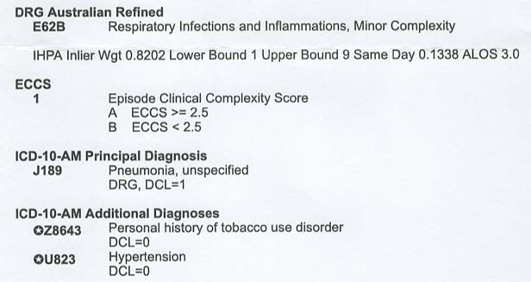
E65B pneumonia

Slide 19
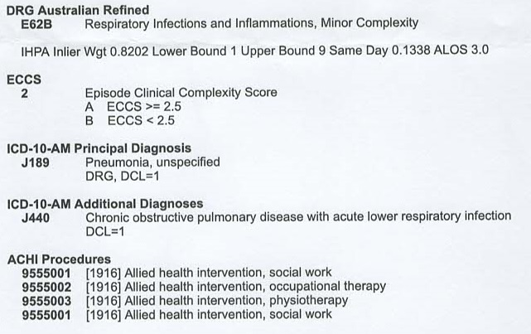
E62B Pneumonia with COPD

Slide 20
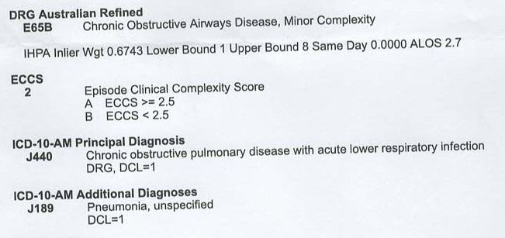
E65B COPD with pneumonia

Slide 21
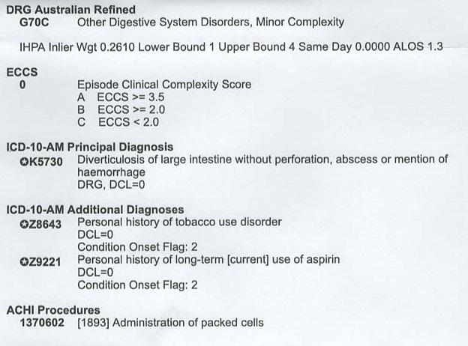
G70C Diverticulosis

Slide 22
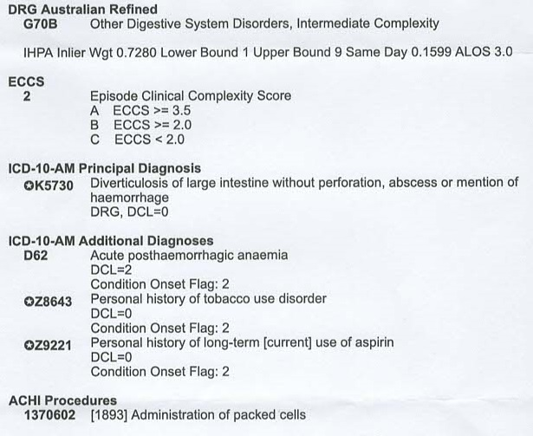
G70B diverticulosis

Slide 23
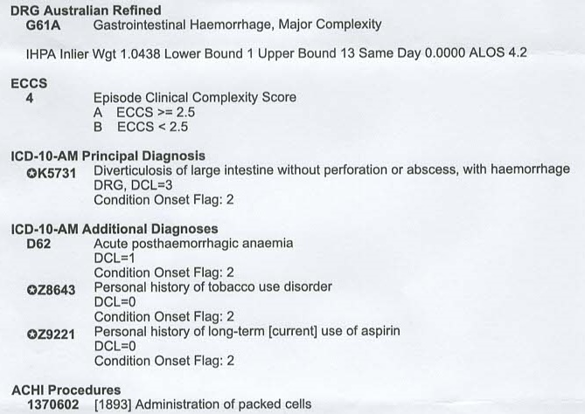
G61A diverticulosis

Slide 24
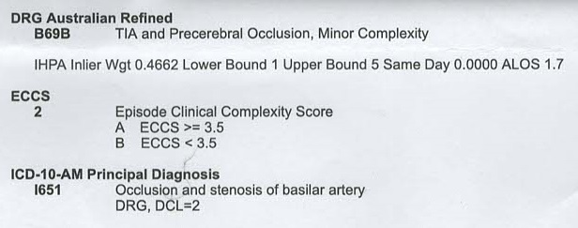
DRG B69B

Slide 25
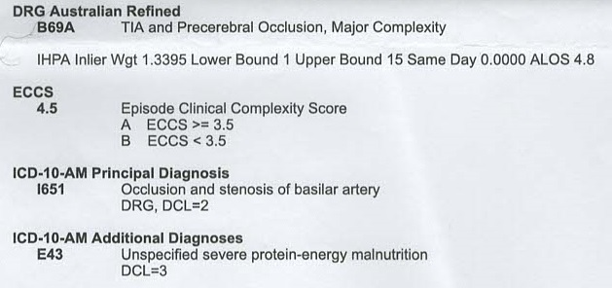
DRG 69A

Slide 26
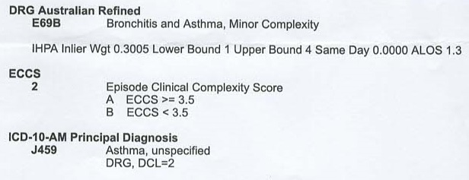
E69B

Slide 27
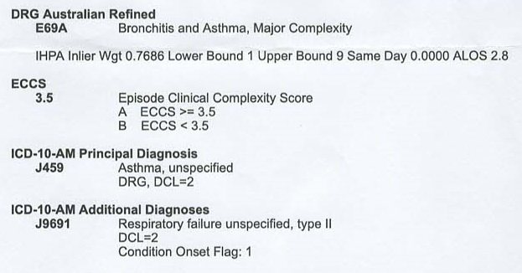
E69A

Slide 28
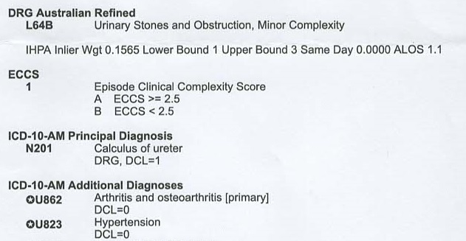
L64B Ureterolith

Slide 29
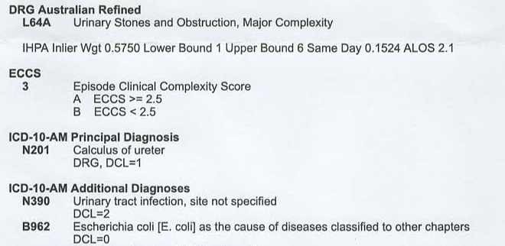
L64A Ureterolith + UTI

Slide 30
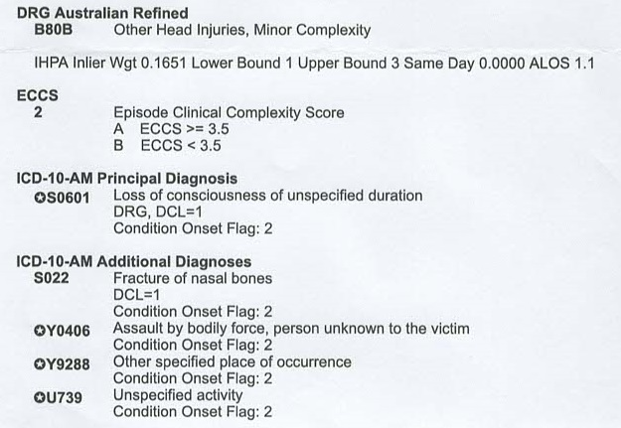
B80B LOC + #

Slide 31
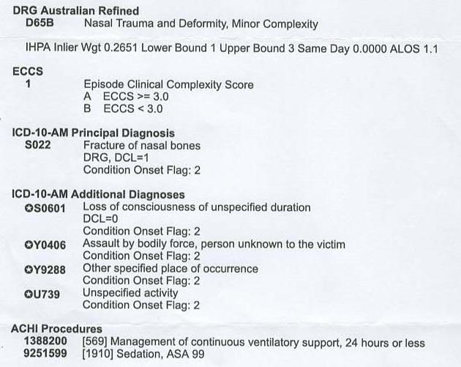
D65B # + LOC

Slide 32
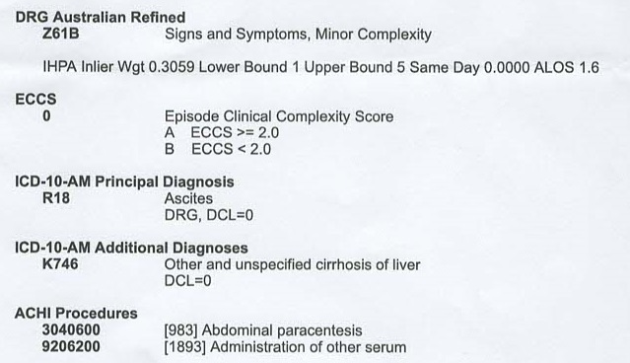
Z61B ascites

Slide 33
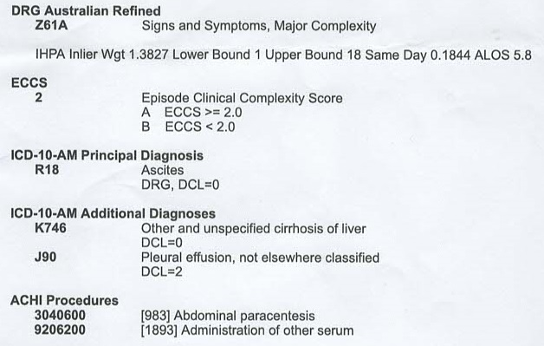
Z61A Ascites + Pleural effusion

