Slide 1

Let’s fly into the next subject
Sugar glider

Slide 2
Prepared by: Anna Coote & Heather Grain
Anaemia
ICD-10-AM 11th edition

Slide 3
Authors
Anna Coote ADip MRA, Dip Tert ED, BA, MHP
Health Information Manger and Clinical Coding Educator
MPH University of NSW
Diploma of Tertiary Education, University of New England
Associate Diploma of Medical Record Administration, College of health Services
Bachelor or Arts, Macquarie University
Heather Grain ADip HIM, Dip TDD, GDip IS, MHI, FAIDH, FMU, FIAHSI
Director of Course Development eHealth Education
Designer and Project Manager eHRol - the Clinical Coder Training Tool
Convener ISO TC215 Health Informatics WG3 Semantic Content
Past Chair HL7 Terminology Authority and Co-Chair Vocabulary
Past Expert SNOMED International Education and representative to Quality and Implementation committees.

Slide 4
Some types of anaemia
Iron deficiency anaemia
Vitamin B₁₂ deficiency anaemia
Folate deficiency anaemia
Other nutritional deficiency anaemia
Haemolytic anaemia
Thalassaemia
Sickle cell disorders
Aplastic anaemia
Post-haemorrhagic anaemia
Notes:
I’m only going to discuss the problematic codes for anaemia, as most can be easily found using the disease index and following any includes and excludes notes in the Tabular list.

Slide 5
Anaemia due to blood loss
The option
The options are:
Anaemia
- due to
- - loss of blood (chronic) D50.0
- - - acute D62
- posthaemorrhagic (chronic) D50.0
- - acute D62
Notes:
These codes can increase the value of the DRG, so it’s important that clinicians document this clearly.
Documentation must be clear. If anaemia and documentation of blood loss on op report, or of menorrhagia, unless documented as DUE TO, then D500 or D62 cannot be assigned.

Slide 6
Anaemia secondary to angiodysplasia of colon
See Coding Rule Q2644
IF angiodysplasia
AND documentation of “with haemorrhage” or “anaemia 2⁰ angiodysplasia
of the colon”
THEN consider the condition to be “due to/with” haemorrhage

Slide 7
Iron deficiency anaemia
Anaemia
- iron deficiency D50.9
- - secondary to blood loss D50.0
Notes:
Secondary to blood loss is the same code as anaemia due to blood loss.

Slide 8
Anaemia due to vitamin B12 deficiency
Anaemia
- deficiency
- - vitamin B12 D51.9
Notes:
Note that there is a separate code for Vitamin B12 deficiency

Slide 9
Blood transfusion
See ∇ACS 0302 Blood transfusions
Code administration of each blood product ONLY ONCE for each admission
Code each type of blood product administered
Notes:
Packed cells, plasma, gammaglobulin, thrombocytes, white cells, etc.

Slide 10
ACHI codes for administration of blood products
The Lead Term is
Administration
- type of agent
- - blood products
Notes:
Note that the lead term Injection now has the instruction to “See Administration”

Slide 11
ACHI codes for administration of blood products
- - - autologous (collected prior to surgery) (intraoperative) 92060-00 [1893]
- - - CAR (chimeric antigen receptor) T-cells 13706-04 [1893]
- - - erythrocytes 13706-02 [1893]
- - - expander (Dextran) (Rheomacrodex) 92063-00 [1893]
- - - gamma globulin 13706-05 [1893]
- - - granulocytes 92064-00 [1893]
- - - immunoglobulin 13706-05 [1893]
- - - leukocytes (donor) 13706-04 [1893]
- - - packed cells 13706-02 [1893]
- - - plasma (FFP) (fresh frozen) 92062-00 [1893]
- - - platelets 13706-03 [1893]
- - - red cells 13706-02 [1893]
- - - serum NEC 92062-00 [1893]
- - - surrogate 92064-00 [1893]
- - - T-cells, CAR (chimeric antigen receptor) 13706-04 [1893]
- - - thrombocytes 13706-03 [1893]
- - - white cells (donor leukocytes) 13706-04 [1893]
^{- - - whole 13706-01 [1893]}
Notes:
Note the option for “autologous”

Slide 12
Iron infusion
The Lead Term is
Administration
- type of agent
- - iron – code to block [1920] with extension -19
Notes:
Iron is not a blood product

Slide 13
Block [1920]
The 5 digit codes in [1920]
Intraarterial
Intramuscular
Intrathecal
Intravenous (infusion)
Subcutaneous
Intracavitary
Enteral
Oral
Other
Unspecified
Notes:
This is a good time to talk about block 1920

Slide 14
Extension codes for [1920]
-00 antineoplastic
-01 thrombolytic
-02 anti-infective
-03 steroid
-04 antidote
-06 insulin
-07 nutritional substance
-08 electrolyte
-10 psychotherapeutic agent
-19 other

Slide 15
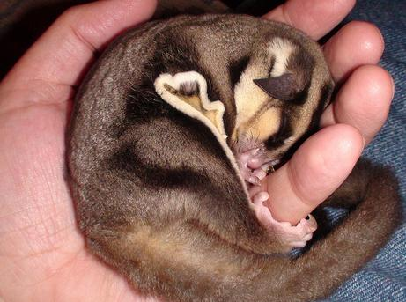
Any questions?

Slide 16
Prepared by: Anna Coote & Heather Grain
Anaemia
ICD-10-AM 11th edition

