Slide 1
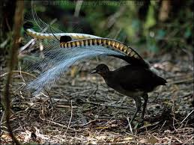
What’s next?
Lyre, (Bower) bird
Notes:
https://www.youtube.com/watch?v=AwxvjrbEkTg

Slide 2
Prepared by: Anna Coote & Heather Grain
Australian Coding Standards
Diagnosis
ICD-10-AM 11th edition

Slide 3
Authors
Anna Coote ADip MRA, Dip Tert ED, BA, MHP
Health Information Manger and Clinical Coding Educator
MPH University of NSW
Diploma of Tertiary Education, University of New England
Associate Diploma of Medical Record Administration, College of health Services
Bachelor or Arts, Macquarie University
Heather Grain ADip HIM, Dip TDD, GDip IS, MHI, FAIDH, FMU, FIAHSI
Director of Course Development eHealth Education
Designer and Project Manager eHRol - the Clinical Coder Training Tool
Convener ISO TC215 Health Informatics WG3 Semantic Content
Past Chair HL7 Terminology Authority and Co-Chair Vocabulary
Past Expert SNOMED International Education and representative to Quality and Implementation committees.

Slide 4
The Australian Coding Standards
The Australian Coding Standards provide the health care sector in Australia with a nationally consistent method of classifying all types of patient, their treatment and associated costs in order to provide better management, measurement and funding.
The 5th volume of ICD-10-AM
Developed with the objective of satisfying sound coding conventions for use with ICD-10-AM and ACHI
They apply to all public and private hospital morbidity coding in Australia (and other users of ICD-10-AM)
Referenced in the Disease and ACHI Tabular List with ∇NNNN
Notes:
The Australian Coding Standards (ACS) are an integral part of the coding process, and Clinical Coders MUST apply the ACS wherever they occur as a reference for a code
If we all code the same way then the data is consistent
Open TCoder and show J449 with ∇NNNN
Open TCoder and show 9625701 (FESS) with ∇NNNN
By the way – note the new rule for FESS
Some standards have sub-headings

Slide 5
Why standards are necessary.
Transurethral resection of prostate and cystoscopy
Admitted for removal of skin lesion, fell out of bed and fractured NOF
Dehydration due to gastroenteritis
Notes:
What is the PDx?
This is why we need rules – Australian Coding Standards
There is also the need for a national organisation to receivre queries, and make the rules.

Slide 6
ACS 0001 Principal Diagnosis
The diagnosis established after study to be chiefly responsible for occasioning an episode of admitted patient care, an episode of residential care or an attendance at the health care establishment, as represented by a code.
Reference: Australian Institute of Health and Welfare 2018
Notes:
“after study” refers to the role of the CC in abstracting and verifying information in the record.
Findings evaluated may include information gained from the history of illness, any mental status evaluation, specialist consultations, physical examination, diagnostic tests or procedures, any surgical procedures, and any pathological or radiological examination.

Slide 7
Problems and underlying conditions
IF the patient presents with a problem
AND the underlying condition is diagnosed first during the admission
THEN assign only a code for the condition.
IF the patient presents with a problem
AND the underlying condition has already been diagnosed at a previous admission
THEN assign the problem as the PDx.
THEN assign the condition as the ADx.
Notes:
NOTE: Eg epilepsy and brain tumour. Eg. SOB, pain, mesothelioma.

Slide 8
Two or more diagnoses or conditions meeting ACS 0001
IF Two or more diagnoses that potentially or equally meet the definition for PDx
AND no further information is available
THEN assign as the PDx the first documented condition.
Notes:
NOTE: Admitted for deviated nasal septum and sinusitis. Rx septoplasty and FESS.

Slide 9
Original treatment not carried out
IF treatment for the reason for admission (the PDx) is cancelled
THEN assign the code for the reason for admission to hospital as the Principal Diagnosis.
THEN assign a code from Z53.-
THEN assign a code for the reason for the cancellation of the procedure.

Slide 10
Aetiology and manifestation convention
The dagger and asterisk convention
Documented in the index with the aetiology sequenced first.
Where both the dagger and asterisk code appear for the Lead Term or modifier in the index, then both must be assigned.
Where the asterisk code appears for the modifier under a Lead Term with an asterisk, then both the dagger and asterisk codes must be assigned.
Candidiasis B37.9
- vagina B37.3† N77.1*
Sequence the aetiology (Dagger) and manifestation (asterisk) codes according to the Principal diagnosis definition.
Notes:
NOTE See Disease Index, introduction, General arrangement of the disease index, code numbers

Slide 11
ACS 0002 Additional Diagnoses
A condition or complaint either coexisting with the principal diagnosis or arising during the episode of admitted patient care, episode of residential care or attendance at a health care establishment, as represented by a code.
Additional diagnoses are conditions that significantly affect patient management in an episode of care in terms of requiring any of the following:
• commencement, alteration or adjustment of therapeutic treatment
• diagnostic interventions
• increased clinical care.

Slide 12
When to code as an additional diagnosis
IF
the condition was treated
medications for the condition were started, changed, or stopped
the condition was monitored (X-rays, tests taken, etc.)
clinicians (nurses/doctors etc) had to do extra work for the condition of the patient
THEN the condition can be coded as an Associated Diagnosis
Notes:
Diagnosis BUT please note the exceptions below.

Slide 13
When not to code as an additional diagnosis
IF a condition is transient and can be treated with medication
AND no consultation, investigation or plan or care
THEN a code is not assigned
IF a condition is pre-existing
AND ongoing medication is administered
THEN a code is not assigned
IF a condition is pre-existing
AND there is a minor adjustment to the diagnostic workup or care plan
THEN a code is not assigned
IF a condition is ONLY treated with nurse initiated medication or treatment
THEN a code is not assigned
IF a condition is ONLY investigated by routine tests
THEN a code is not assigned

Slide 14
Clinical care and testing and additional diagnosis/es
IF clinical care for a condition is routine in nature
THEN a code is not assigned
IF clinical care for a condition is BEYOND routine (increased clinical care)
THEN a code is assigned
IF routine tests diagnostic tests
• routine ARO (Antibiotic Resistant Organisms) screening
• full blood count (FBC)
• functional tests (eg liver or kidney function)
THEN a code is not assigned
IF a diagnostic test is ordered to establish a Dx or provide greater specificity to a Dx
THEN a code is assigned if confirmed by the test
Notes:
NOTES
aperients given for constipation
Has HTN, continues to take his/her medication for HTN
HTN meds reduced due to an episode of hypotension
Aspirin given for headache
Admitted for COPD, continued dressings for existing ulcer
See ACS 0002, subheading INCREASED CLINICAL CARE

Slide 15
Additional diagnosis for increased clinical care
Care beyond that normally provided by clinicians
Clinical consultation for a condition with documentation of:
a clinical assessment, and
a diagnosis, and
a care plan for the condition.
Performance of a therapeutic treatment/intervention
Pre- and post-operative management in excess of routine care
Notes:
A condition meets the requirements of ACS 0002 if:

Slide 16
Clinical care not significant, not an additional diagnosis
General nursing care
Assessment of vital signs
Assessment of pre-existing conditions without a care plan
Pre- and post-operative management
Notes:
A condition DOES NOT meet the requirements of ACS 0002 where the following applies:

Slide 17
Exceptions to ACS 0002
Viral hepatitis
(Hepatitis A, B, C, D, and E).
∇ACS 0104 Viral Hepatitis
HIV/AIDS
∇ACS 0102
Use of tobacco
∇ACS 0503
Diabetes and intermediate hyperglycaemia
∇ACS 0401

Slide 18
ACS 0038 Condition onset flag COF
“The condition onset flag (COF) is a means of differentiating those conditions which arise during, from those arising before, an admitted patient episode of care.”
There are two Condition Onset flags:
COF 1 - condition with onset during the episode of admitted care.
COF 2 – Condition arising before the episode of admitted patient care.

Slide 19
COF 2
A condition previously existing or suspected on admission such as the presenting problem, a comorbidity or chronic disease.
IF a condition is diagnosed during an admission
AND the condition was present before admission
THEN the condition is assigned COF 2.
Notes:
A common mistake is to assign COF 1 to a condition which is diagnosed during the admission.
For example a patient was admitted with cough and wheeze, and was diagnosed with asthma.
The patient had asthma prior to admission, and it was diagnosed during the admission.
The timing of the diagnosis is not the determining factor in assigning the COF.

Slide 20
COF 1
COF 1 is assigned to new conditions, which arose after the patient was admitted, and during the admission.
IF a condition was not present (or suspected) on admission
AND the condition arose during the admission
THEN the condition is assigned COF 1,

Slide 21
ACS 0003 Supplementary codes for chronic conditions
Supplementary codes are assigned for conditions present on admission which do not meet the requirements of ACS 0002 or ACS 0001
The condition must not be part of the patient’s history but which is no longer present
Supplementary codes should be sequenced after all other ICD-10-AM codes.
The supplementary codes are not assigned:
• in addition to another chapter code for the same condition
• for a past history of a condition
• for an acute condition.
Notes:
These codes are for use in Australia to generate data which will be utilised to review the coding of additional diagnoses.
The codes are mapped so as not to be included in the grouping for Diagnosis Related Group (DRG) allocation.

Slide 22
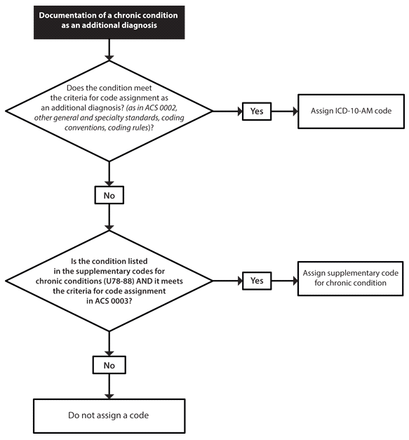
Supplementary codes flow chart
Notes:
Hard to read, and I’ve put it here to indicate to you tht you can view this in your ICD-10-AM

Slide 23
Do not code….
Incidental findings
A finding relating to another body system which is not currently being treated, and which does not require treatment during the current admission.
Risk Factors
Risk factors are only coded if they meet the requirements of ∇ACS 0001 or ∇ACS 0002.
Family and personal history
Only coded when they meet the requirements of ∇ACS 0001 or ∇ACS 0002 or ∇ACS 0052.
Notes:
An investigation or test for a condition meeting the requirements of ∇ACS 0001 or ACS 0002 for the episode, may result in a finding relating to another body system which is not currently being treated, and which does not require treatment during the current admission.
This is an INCIDENTAL finding.
CLASSIFICATION:
“… where these findings or conditions are incidental to the episode of care and are only flagged for follow-up or referral post discharge they do not qualify for code assignment under ∇ACS 0002 Additional diagnoses.”
For eg. noted hyperthyroidism for FU in outpatients
for eg HTN not treated, but a risk factor for IHD. Unless treated HTN is not coded in an admission for IHD (supp codes).

Slide 24
Australian Coding Rules
The Australian Coding Rules are:
Interim decisions published between editions of ICD-10-AM
The outcome of the Coding Query Response process
Referenced in the Disease and ACHI Tabular List with the icon.
If not using an electronic version of ICD-10-AM the Coding Rules can be found at:
https://www.ihacpa.gov.au/resources/national-coding-advice.
Notes:
The Australian Coding Rules are also an integral part of the coding process. Wherever this icon occurs
the Clinical Coder must review the Coding Rule to determine its relevance to the coding task.

Slide 25

Standards create a structure for coding
Bower bird nest
© 2014
Notes:
Bower birds love blue objects

Slide 26
Prepared by: Anna Coote & Heather Grain
Australian Coding Standards
Diagnosis
ICD-10-AM 11th edition

