Slide 1
PREPARED BY: Anna Coote & Heather Grain
Introduction to Coder Training
ICD-10-AM 11th edition

Slide 2
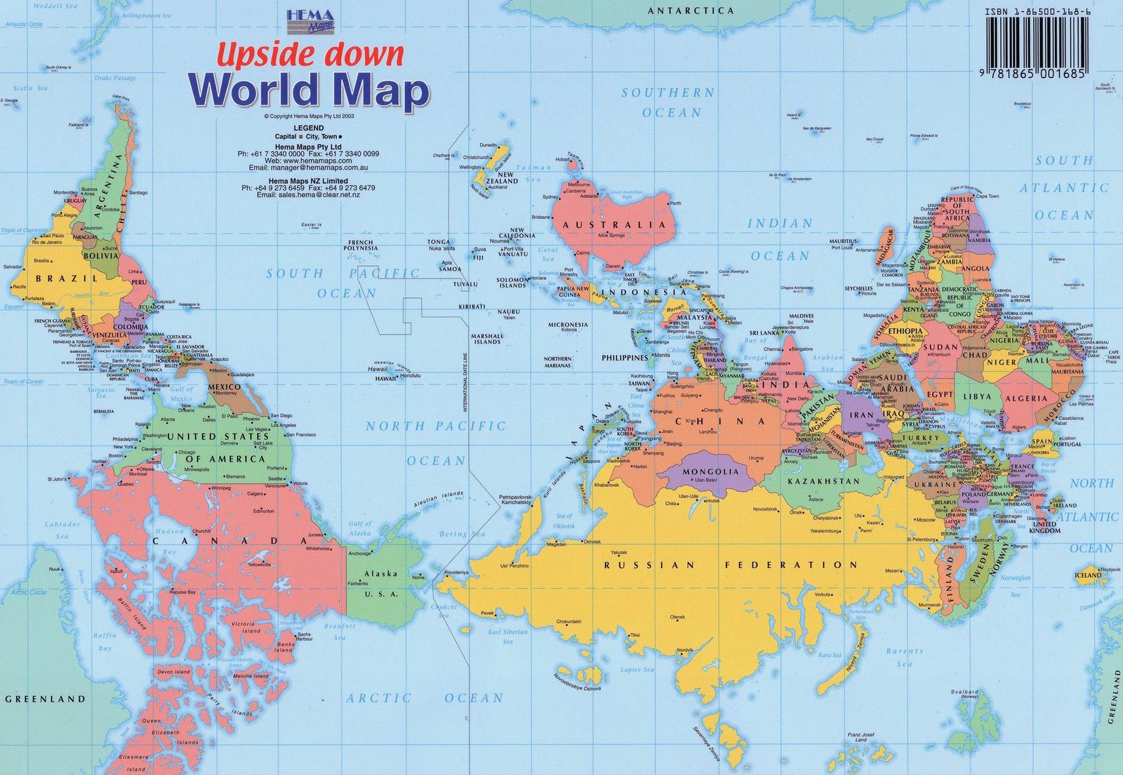
Australian view of the world

Slide 3
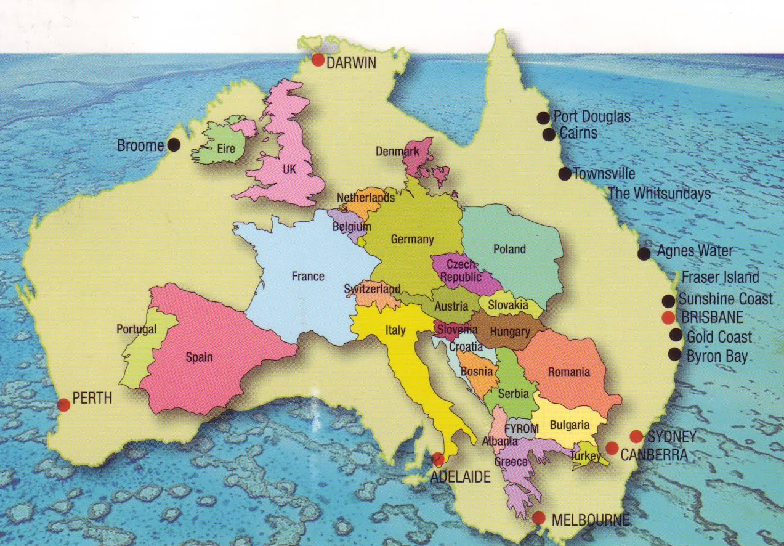
Relative sizes

Slide 4
Authors
Anna Coote ADip MRA, Dip Tert ED, BA, MHP
Director and Senior Coding Educator, CCE
Health Information Manager and Clinical Coding Educator
MPH University of NSW
Diploma of Tertiary Education, University of New England
Associate Diploma of Medical Record Administration, College of health Services
Bachelor or Arts, Macquarie University
Heather Grain ADip HIM, Dip TDD, GDip IS, MHI, FAIDH, FMU, FIAHSI
Director of Course Development eHealth Education
Designer and Project Manager eHRol - the Clinical Coder Training Tool
Convener ISO TC215 Health Informatics WG3 Semantic Content
Past Chair HL7 Terminology Authority and Co-Chair Vocabulary
Past Expert SNOMED International Education and representative to Quality and Implementation committees.
Co-Chair Education Program Board openEHR

Slide 5


The leading digital health and clinical coding education providing nationally recognised training since 2008
Vision: a digitally empowered and capable health workforce
Our Philosophy is to:
Share the knowledge and skills of world digital health experts with learners, educators and others
Focus on practical, success and future focused education for the healthcare workforce.

Slide 6

Clinical Coding Education
Consulting in Health Information Management
Face-to-face and online clinical coder training
Clinical Coding audit services

Slide 7
Course objectives
Basic principles of documentation and analysis for coders
Coding training in preparation for the use of DRGs
Upgrading coder skills to ICD-10-AM 11th edition
Upgrading supervising doctors’ skills to ICD-10-AM 11th edition
Coder training in the use of ACHI
Introducing coders and supervising doctors to the basic principles of Disease and ACHI indices
Review of Australian Coding Standards and Coding Rules

Slide 8
PREPARED BY: Anna Coote & Heather Grain
Introduction to Coder Training
ICD-10-AM 11th edition

